Slide 1
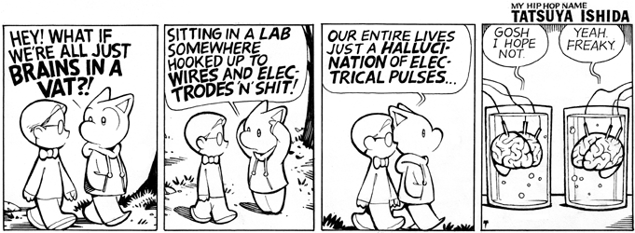
Appearance and Reality
PH1102E/GEK1067, Week 12

Slide 2
Today’s Plan
BIVs and SIMs
Skepticism vs. Metaphysics
Some Major Metaphysical Theories

Slide 3
i. Bivs and sims

Slide 4
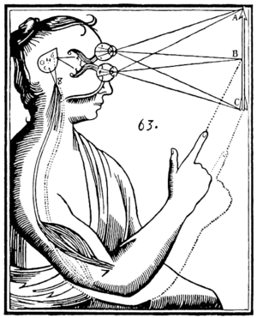
Common Sense Hypothesis

Slide 5
Common Sense Hypothesis
Your brain gives rise to your conscious experiences in response to signals from your sensory organs, which are reacting to various things in your natural environment.

Slide 6
BIV Hypothesis

Slide 7
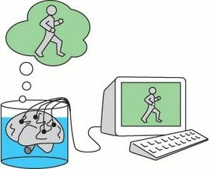
BIV Hypothesis
Your brain gives rise to your conscious experiences in response to signals from a super-computer to which your brain is directly attached.

Slide 8
Simulation Hypothesis

Slide 9
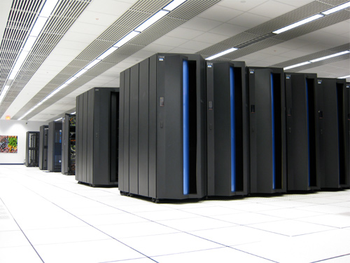
Simulation Hypothesis
Your conscious experiences arise directly from the operations of a supercomputer that is running a Bostrom-style ancestor simulation.

Slide 11
ii. Skepticism vs metaphysics

Slide 12
Question: Which of these hypotheses is compatible with the claim that you are not massively deceived about the nature of reality?

Slide 13
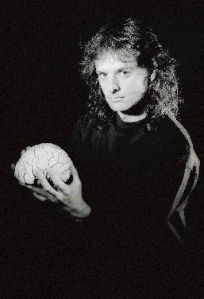
David Chalmers

Slide 14
They all are!
The BIV hypothesis and the Simulation hypothesis are not skeptical hypotheses, they are metaphysical hypotheses.
David Chalmers

Slide 15
They all are!
The BIV hypothesis and the Simulation hypothesis are not skeptical hypotheses, they are metaphysical hypotheses.
David Chalmers

Slide 16
A skeptical hypothesis is a claim which, if true, implies that most of our beliefs are false.
A metaphysical hypothesis is a claim about the deep, underlying nature of our world.

Slide 17
A Skeptical Hypothesis

Slide 18
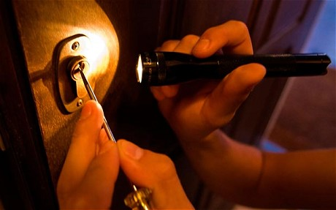
A Skeptical Hypothesis

Slide 19

A Skeptical Hypothesis

Slide 20
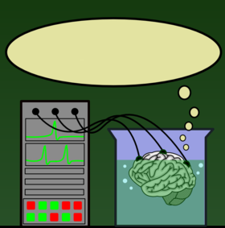
A Skeptical Hypothesis
I’m sitting in an auditorium, listening to Pelczar yet again.

Slide 21
A Skeptical Hypothesis
The brain-snatcher hypothesis is a skeptical hypothesis, because if it’s true, very many of your beliefs are false.
For example, your belief that you are listening to Pelczar give a philosophy lecture is false, as is your belief that you are sitting next to some other students, your belief that you have a (complete) body, etc.

Slide 23
Some Metaphysical Hypotheses

Slide 24
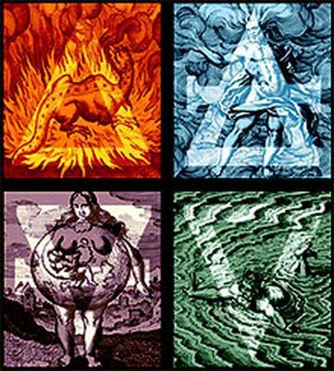
Some Metaphysical Hypotheses
According to ancient Greek scientists, everything in our Universe is composed of Earth, Air, Fire, and Water.
This is a metaphysical hypothesis: a claim about the deep underlying nature of our world.

Slide 25
Some Metaphysical Hypotheses

Slide 26

Some Metaphysical Hypotheses
According to present-day scientists, everything in our Universe is composed of elementary particles.
This too is a metaphysical hypothesis: a claim about the deep underlying nature of our world.

Slide 27
Some Metaphysical Hypotheses

Slide 28
Some Metaphysical Hypotheses
Well, according to certain followers of Nick Bostrom, everything in our Universe is composed of computational states of a powerful computer.
This is a metaphysical hypothesis: a claim about the deep underlying nature of our world.

Slide 29
Some Metaphysical Hypotheses

Slide 30
Some Metaphysical Hypotheses
Furthermore, the Simulation Hypothesis is not a skeptical hypothesis.
After all, if a scientist from ancient Greece could visit us today, would he conclude that he had been wrong to believe that there were such things as trees?

Slide 31
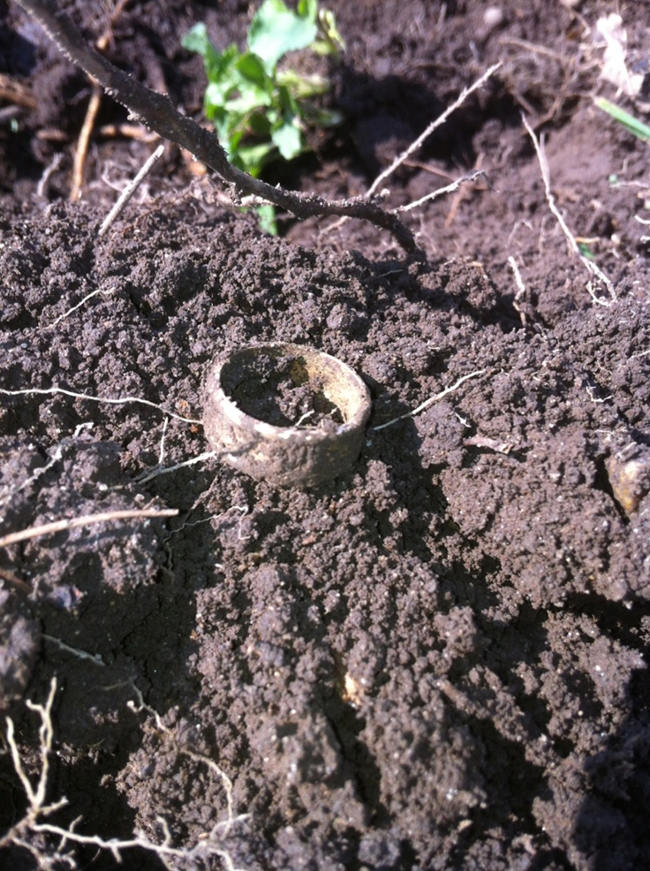
Some Metaphysical Hypotheses
Furthermore, the Simulation Hypothesis is not a skeptical hypothesis.
After all, if a scientist from ancient Greece could visit us today, would he conclude that he had been wrong to believe that there were such things as trees?

Slide 32
Some Metaphysical Hypotheses

Slide 33
Some Metaphysical Hypotheses
“So is Chalmers saying that there literally are trees, lakes, mountains, etc. inside the computer that runs the ancestor simulation (or that stimulates the BIV)?”

Slide 34
Some Metaphysical Hypotheses
No.
If we build such a computer, there won’t be any trees inside it.
But the Sims who live in the computer will say something true in their language when they say: “We see trees!”

Slide 35
Some Metaphysical Hypotheses
Likewise, if, as the Simulation Hypothesis states, we live in a computer simulation, then we speak truly when we say: “We see trees!”
This, despite the fact that we don’t see any of the things that our Simulators call “trees.”

Slide 36
iii. Some major metaphysical theories

Slide 38
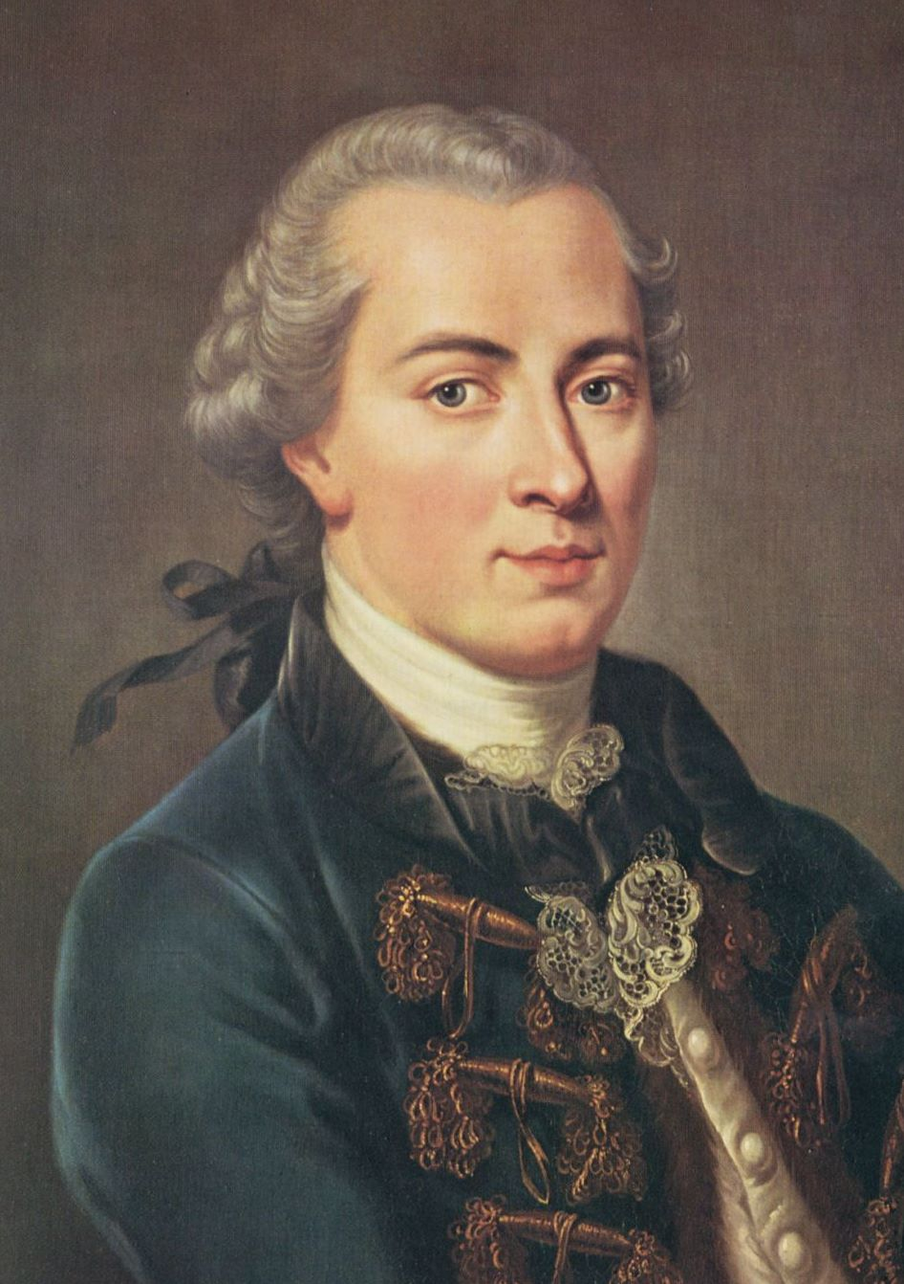
Kant
Immanuel Kant (1724-1804)

Slide 39
Kant
For a physical thing, such as a tree, to exist is simply for there to be something that has the power to give us experiences of a tree.
We can know nothing about this thing except that it has the power to give us experiences of a tree.
Immanuel Kant (1724-1804)

Slide 40
Kant
For a physical thing, such as a tree, to exist is simply for there to be something that has the power to give us experiences of a tree.
We can know nothing about this thing except that it has the power to give us experiences of a tree.
Immanuel Kant (1724-1804)

Slide 42
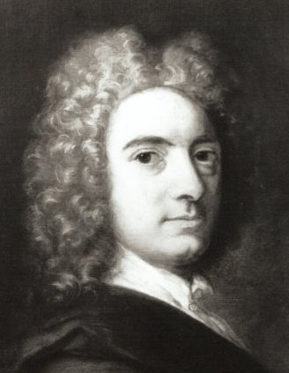
Berkeley
For a tree to exist is simply for there to be something that has the power to give us experiences of a tree.
The thing that has this power is God.
George Berkeley (1685-1753)

Slide 43
Berkeley
For a tree to exist is simply for there to be something that has the power to give us experiences of a tree.
The thing that has this power is God.
George Berkeley (1685-1753)

Slide 45
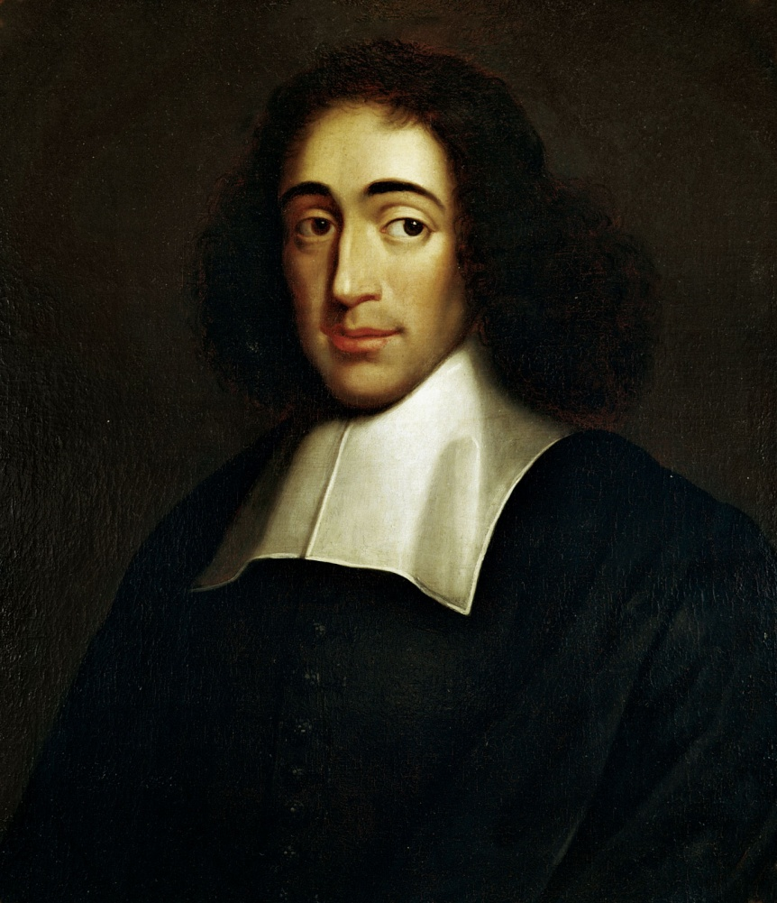
Spinoza
Baruch Spinoza (1632-1677)

Slide 46
Spinoza
The natural world is whatever has the power to give us experiences of natural phenomena.
What has this power is God.
Therefore, God = the natural world.
God is God-or-Nature (Deus sive Natura).
Baruch Spinoza (1632-1677)

Slide 47
Spinoza
The natural world is whatever has the power to give us experiences of natural phenomena.
What has this power is God.
Therefore, God = the natural world.
God is God-or-Nature (Deus sive Natura).
Baruch Spinoza (1632-1677)

Slide 48
Spinoza
The natural world is whatever has the power to give us experiences of natural phenomena.
What has this power is God.
Therefore, God = the natural world.
God is God-or-Nature (Deus sive Natura).
Baruch Spinoza (1632-1677)

Slide 50
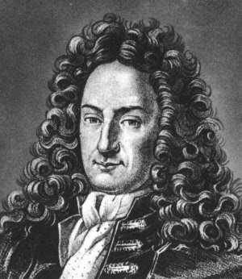
Leibniz
Gottfried Leibniz (1646-1716)

Slide 51
Leibniz
For a tree to exist is for it to be the case that the more experiences minds have, the more likely it is that we can interpret the totality of all experiences as including perceptions of a tree.
The world fundamentally consists of “monads”: minds that run autonomous experiential programs.
Gottfried Leibniz (1646-1716)

Slide 52
Leibniz
For a tree to exist is for it to be the case that the more experiences minds have, the more likely it is that we can interpret the totality of all experiences as including perceptions of a tree.
The world fundamentally consists of “monads”: minds that run autonomous experiential programs.
Gottfried Leibniz (1646-1716)

Slide 54
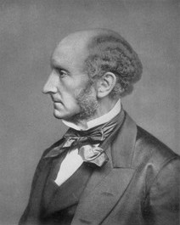
Mill
John Stuart Mill (1806-1873)

Slide 55
Mill
For a tree to exist is for it to be the case that the more experiences occur, the more likely it is that we can interpret the totality of all experiences as including perceptions of a tree.
The world fundamentally consists of experiences: minds are just bundles of experiences, and do not exist “over and above” the experiences that constitute them.
John Stuart Mill (1806-1873)

Slide 56
Mill
For a tree to exist is for it to be the case that the more experiences occur, the more likely it is that we can interpret the totality of all experiences as including perceptions of a tree.
The world fundamentally consists of experiences: minds are just bundles of experiences, and do not exist “over and above” the experiences that constitute them.
John Stuart Mill (1806-1873)

Slide 57
PH2206: Founders of Modern Philosophy
PH2207: Hume and Kant
PH2213: Metaphysics
PH3244: Appearance and Reality

Slide 58
No more summaries!

